Slide 1
What’s My Drop?
How do I know what lozenge(s) to take or give away?

Slide 2
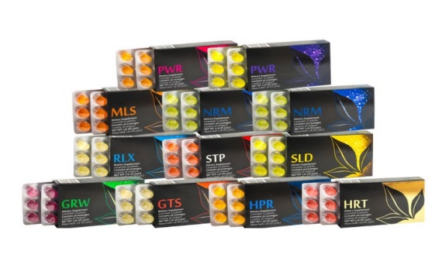
About the Drops
17 in total with a new one to be released soon
100% plant DNA using the highest standards for growing, picking, harvesting and manufacturing.
Uses a patented extraction method (Pretty cool stuff).
Safe, effective, immediate acting.
Can be used by all ages and pets!

Slide 3
The Drops!
GRW – Grow
SLD – Slide*
STP – Stop*
NRM – Norm*
Power – Apricot
Power – Lemon
HRT – Heart
GTS – Get Strength*
RLX – Relax*
MLS – Multi Spectrum
ALT – Allergies*
ICE – Ice*
HPR – Hepar
BRN – Brain*
BTY – Beauty
AIR – Air/breathing*
HPY – Happy*
?
Why the asterisk?

Slide 4
But…What’s my drop or how do I help others?
Some housekeeping!
DNA drops do not treat, or cure and you cannot diagnose.
There are two types of drops – those you may feel and those on the cellular level that you will not feel but works from the inside out.
Always think of the body as a whole, not just one thing that something is out of balance.
What I mention is not set in stone – feel free to change any of these out.

Slide 5
Most Important!
DNA Drops are not a miracle cure…
They should be used in conjunction with other modalities.
To explain, use my golf ball analogy!

Slide 6
Challenges
Blood Sugar
Brain Issues
NRM
MLS
HPR
HRT
PWR
RLX
Others - AIR
BRN
MLS
HPR
SLD
STP
Others – GRW, BTY

Slide 7
Challenges
Allergies
Hormones
ALT
MLS
GRW
STP
RLX
Others – SLD, AIR
PWR – both
MLS
GRW
GTS
RLX
Others – HPY, AIR

Slide 8
Challenges
Heart
Over Exercise, Old Sport Injuries, etc.
HRT
SLD
STP
RLX
GRW
Others – AIR, BTY
SLD – Extra at night
STP – Extra at night
GTS
RLX

Slide 9
Challenges
Sleep
Stress, Anxiety, Blues
RLX
MLS
STP
SLD
Other HPY, AIR
HPY
RLX
MLS
HPR
GRW
Others – AIR, GTS, PWR

Slide 10
Challenges
Digestive Distress (Any)
Microbiome
ICE
MLS
SLD
STP
HPR
RLX
Other - NRM
MLS
GRW
HPR
STP
SLD
RLX
Others – BTY

Slide 11
Challenges
Detox
Autoimmune
HPR
MLS
GTS
ICE
RLX
Others – HPY, AIR, BTY
MLS
GRW
SLD
HPR
RLX
Others – Air, BTY, HPY

Slide 12
Challenges
Long Covid
What are you looking to support?
AIR
SLD
STP
ALT
HPR
SLD
Other – BTY, HPY
Let’s find out!

